Slide 1
CSCIU 210 Computer Organization AKM Jahangir A Majumder, PhD
Fall 2018 - Lecture 16
October 1, 2018
Note: Some slides are adapted from those used by previous instructors and some slides include figures from the textbook.

Slide 2
Review and Learning Outcomes
We will continue to cover how to do math in the binary format and how to implement it in hardware
2’s complement
Multiplications and Divisions
Decoder and Multiplexer
Homework 3 is posted on Blackboard which is due on Wednesday, October 3 at the beginning of the class
We will have one more quiz before our exam 1 [(quiz 3) on Wednesday, October 3], which will be on lectures 10-15
We will have our Exam 1 on Friday, October 5, 2018, which will be on lecture 1-15
A sample exam with key will post on Blackboard soon

Slide 3
Overflow and Review of 2’s Complement Math
2’s complement is widely used in computers.
To get a two’s complement of a number (positive or negative), we invert every bit and then add one.
For N-bit signed integer, its range is -2^{n-1}~2^{n-1}-1 (Assume 2’s complement is used)
The reason why 2’s complement is used is that we can use the same circuit to perform addition and subtraction.
Overflow will happen when the calculation result is outside of the representation range.

Slide 4
Multiplication and Division by Shifting Bits
We will cover multiplication in great details later. However, some simple multiplication can be accomplished simply by shifting the bit sequence.

Slide 5
Shift Operations
Move (shift) all the bits in a word to the left or right by a number of bits.
Example: shift right by 8 bits
0001 0010 0011 0100 0101 0110 0111 1000
0000 0000 0001 0010 0011 0100 0101 0110
Example: shift left by 8 bits
0001 0010 0011 0100 0101 0110 0111 1000
0011 0100 0101 0110 0111 1000 0000 0000

Slide 6
Shifting and Multiplication
Shift Left a binary number by i bits will give the same result as multiplying by 2^{i}. (True or False)
Shift Right a binary number by i bits will give the same result as dividing by 2^{i}. (True or False)

Slide 7
Intermission
We covered the following important concepts today:
Overflow detection
Shifting for multiplication
What we don’t cover about binary math:
Multiplication and Division Implementation
Floating Point Operation
However, we will begin to use the concepts we covered up to now to build a simple ALU.
Two necessary building block, decoder and multiplexer need to be introduced.

Slide 8
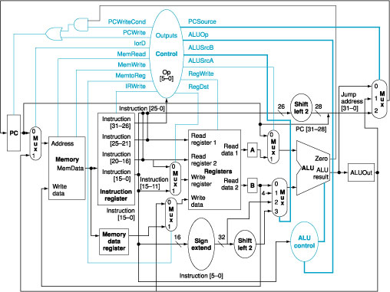
Where Can You Find the ALU in a MIPS Computer?
_{ALU}

Slide 9
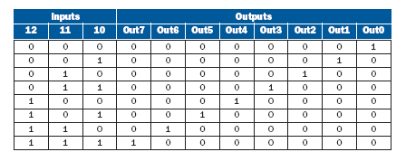
Function of a Decoder
3 bit
decoder
Out 0
Out 1
I0
Out 2
I1
Out 3
I2
Out 4
Out 5
Out 6
Out 7

Slide 10
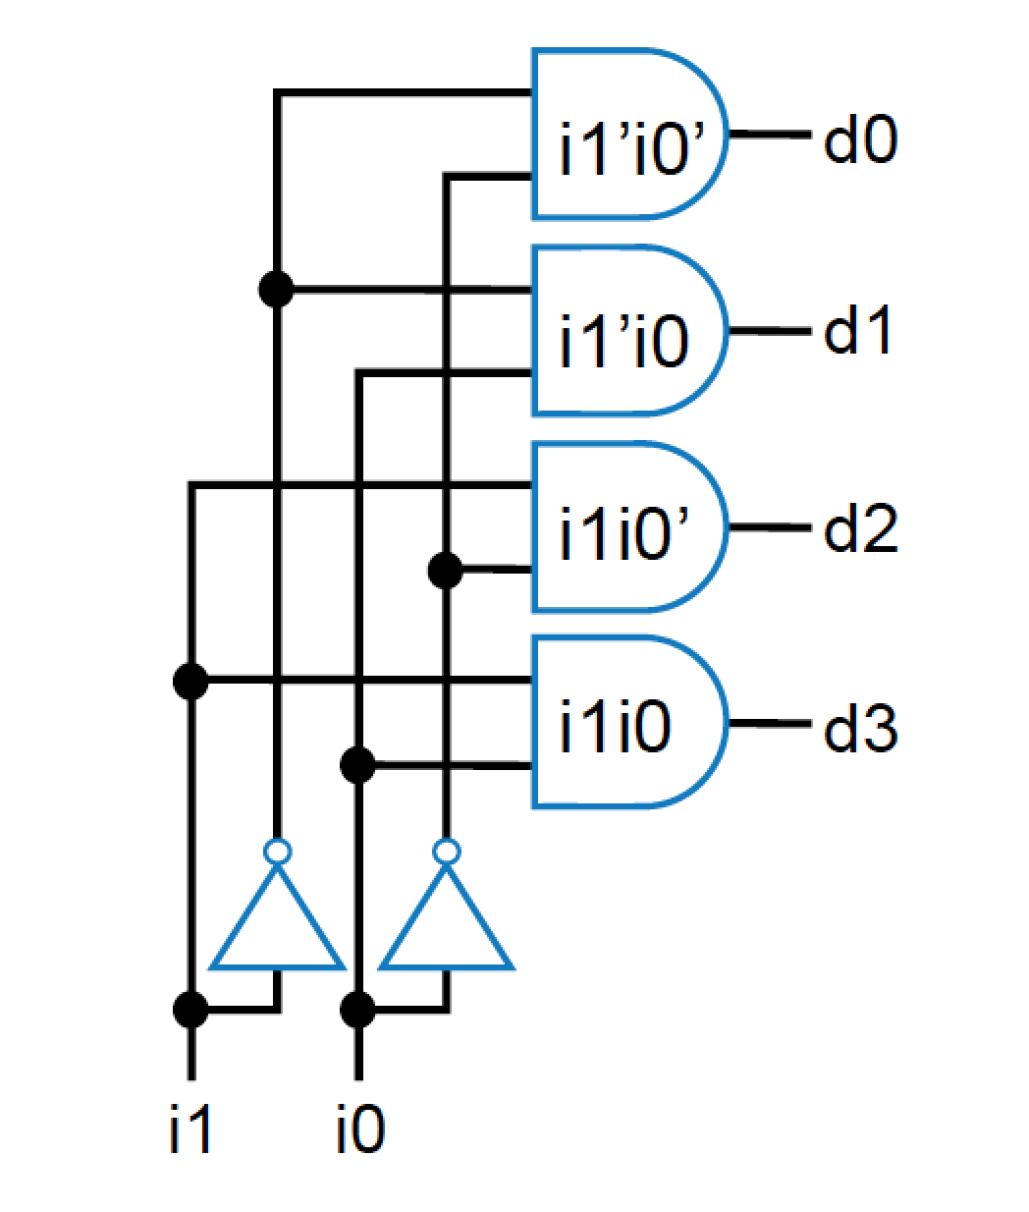
Decoder: Internal design
AND gate for each output to detect input combination

Slide 11
How to Build a Decoder?
1-to-2-Line Decoder
2-to-4-Line Decoder
A
D
0
D
1
D
0
=
A’
0
1
0
1
0
1
A
D
=
A
1
(a)
(b)
A
0
A
1
A
0
D
0
D
1
D
2
D
3
A
1
0
0
1
0
0
0
D
=
A’
A’
0
1
0
1
0
0
0
1
0
1
0
0
0
1
0
1
1
0
0
0
1
D
1
=
A’
A
1
0
(a)
D
2
=
A
1
A’
0
D
3
=
A
1
A
0
(b)

Slide 12
Decoder Expansion

Slide 13
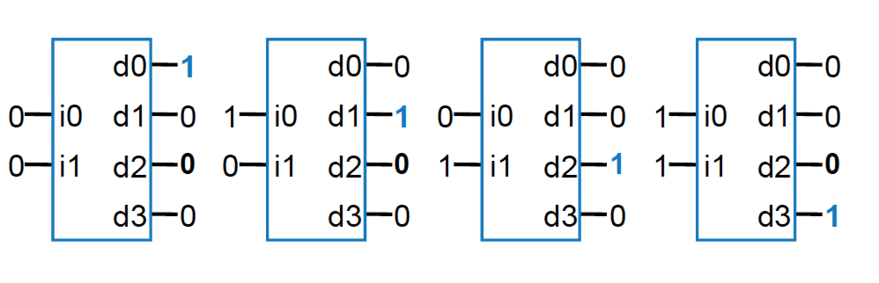
Decoder
Popular combinational logic building block, in addition to logic gates
Collection of logic gates which are arranged in a specific way that converts input binary number to one high output
2-input decoder: four possible input binary numbers... So has four outputs, one for each possible input binary number

Slide 14
Decoder with enable e
Outputs all 0 if e=0
Regular behavior if e=1
d0
0
1
i0
d1
0
1
i1
d2
0
e
d3
1
1
d0
0
1
i0
d1
0
1
i1
d2
0
e
d3
0
n-input decoder: 2n outputs
0

Slide 15
Function of an Multiplexer
4-1 multiplexer
S₁ | S₀ | Y
0 | 0 | I₀
0 | 1 | I₁
1 | 0 | I₂
1 | 1 | I₃
I0
Mux
I1
I2
Y
I3
2
s

Slide 16
Building of a 2-to-1-Line Multiplexer
The single selection variable S has two values:
S = 0 selects input I₀
S = 1 selects input I₁
The equation:
Y = S’I₀ + SI₁
The circuit:

Slide 17
Building of 4-to-1-line Multiplexer
2-to-2²-line decoder
2² × 2 AND-OR

Slide 18
Demultiplexer (demux)
A demux performs the reverse operation from the mux
The demux routes one input to 1-of-n outputs based on the select-line input combination
System description for 4 output demux (2 select-lines)
y₀ = i·s₁’·s₀’
y₁ = i·s₁’·s₀
y₂ = i·s₁·s₀’
y₃ = i·s₁·s₀
Recall from the decoder a description could be given as follows:
y₀ = G·s₁’·s₀’
y₁ = G·s₁’·s₀
y₂ = G·s₁·s₀’
y₃ = G·s₁·s₀

Slide 19
Demux (concluded)
You can see, from the previous expressions, that the demux could be implemented with a decoder that has an enable
Just connect I to G of the decoder and you have a demux.
Warning: Most CAD tools rely on the user knowing this fact … … the libraries do not contain any demuxes, just decoders.
0
y₀
y₀
0
y₀
y₀
2x4 decoder
2x4 decoder
i₀
y₁
y₁
i₀
y₁
y₁
0
i₁
y₂
y₂
1
i₁
y₂
y₂
s₀
y₀
y₀
2x4 decoder
s₁
i₀
y₁
y₁
i
G
y₃
y₃
i
G
y₃
y₃
i₁
y₂
y₂
i
G
y₃
y₃
1
y₀
y₀
1
y₀
y₀
2x4 decoder
2x4 decoder
i₀
y₁
y₁
i₀
y₁
y₁
0
i₁
y₂
y₂
1
i₁
y₂
y₂
i
G
y₃
y₃
i
G
y₃
y₃

Slide 20
Summary
Today, Introduced decoder and multiplexer.

